Slide 1
A discussion of Anes Makul’s paper: Can the European Public Block the Enlargement to the Western Balkans?
Daniela Lenčéš Chalániová
21 October 2014

Slide 2
Enlargements from candidate’s perspectives
For economic reasons (UK, DK, IRL and later SWE, AT, FIN)
For political and economic reasons (GR, ESP, PORT)
2004 enlargement: political, cultural, emotional and economic appeal
Membership in the EU = a “return to Europe”
A confirmation of a successful transition and political belonging with the developed countries of Western Europe
2007/2013 roughly the same

Slide 3
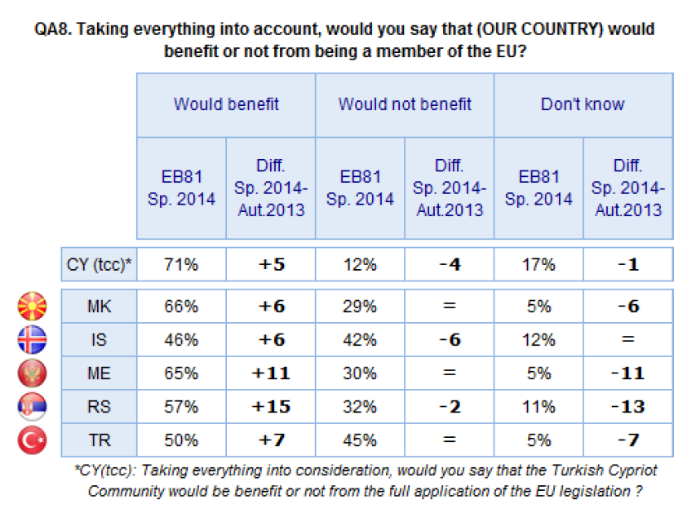
Enlargement from candidate’s perspectives TODAY
Eurobarometer 81 (July 2014):
- support for membership has increased compared with 2013
- Maidan in Ukraine
for a European future
of Ukraine
Notes:
Eurobarometer 81

Slide 4
European Union’s perspective on Enlargement?
1970s - Success story - yes, peace in Europe is possible
1990s/2004 - Victory of the liberal democratic order
Post 2004 - Stability and regionalism
First enlargements were not “burdened” with the weight of a public opinion (issue of the elites: deGaulle’s ‘non’)
1990s: EU’s democratic deficit – lack of EU demos
Days of the “permissive consensus” seem to be over…
But is there a European public now?

Slide 5
Is there a European public?
Research suggests that indeed since 2000s, we can speak of “Europeanized public spheres” (T. Risse)
Even more politicization of EU affairs throughout the crisis
Majority of the publics is willing to be solidary (redistribution within the EU – bail-outs) BUT ON THE OTHER HAND
Recent success of “Eurosceptics” of all stripe and colour suggests that the EU institutions as well as national governments will have to take these voices more seriously, as they push the mainstream to extreme
Euroscepticism often accompanied by nationalism (UK: UKIP; FR: Front National; GR: Golden Dawn, Independent Greeks); NL: Party for Freedom; AT: BZO, FPO)
(CR: Usvit, DSSS; PL: Law and Justice; HU: Jobbik; SK: SNS, SaS)

Slide 6
European public(s)
European moderates are unable to present a united front
- hard to find arguments and support for integration and EU policies (multiple voices)
Easily picked apart by the Eurosceptics
- Especially in a situation of lack of knowledge about the EU
- People give in easily to stereotype and prejudice
Declining support revolves around issues of economy and migration (but this is rather characteristic for the whole EU integration project)

Slide 7
Economic “reasons”
Iceland’s accession would be no problem
Central East European countries are less willing to redistribute (Risse 2014) thus it could explain the decline of their support for integration (compare the Greek scenario, when their PM blackmailed the EC for CAP subsidies in the face of ESP + PORT enlargement)
Imagine Albania – the synonym of corruption - an EU member!

Slide 8
Migration
Polish plumber 2.0
Creation of fault-lines even within the EU, let alone without!
- UK today tries to limit intra-EU migration (under pressure from UKIP)
- FR tried to send the Roma “home”
Stereotypes of Others (internal & external)
“Balkanism” Bai Ganio (Bulgaria)
Imagine Bosnian Muslims in the EU today!
Notes:
Alina Curticapean (2008) in Perspectives: Bai Ganio and Other Men’s Journeys to Europe

Slide 9
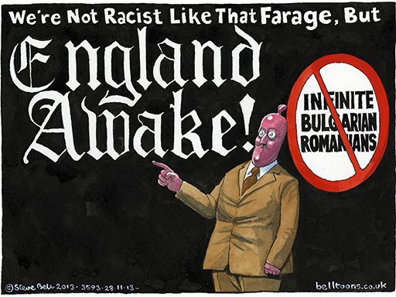
United Kingdom
© Dave Brown on Eastern European immigration to UK, The Independent 13th August 2013
© Steve Bell on Tory immigration policy, The Guardian 28th November 2013

Slide 10
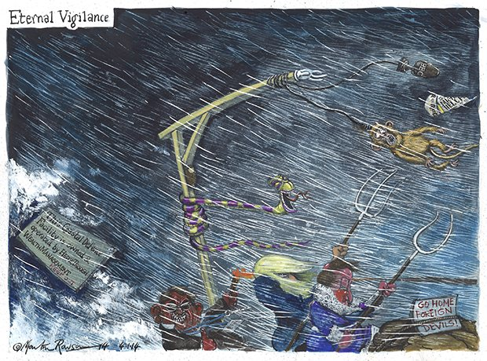
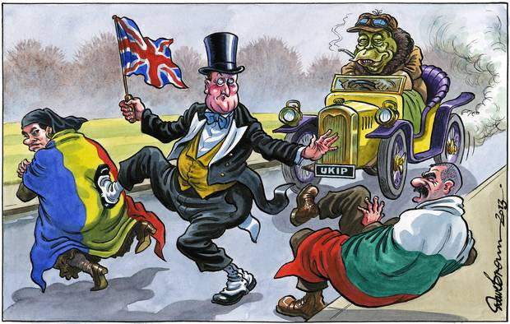
United Kingdom
© Dave Brown lifting off of the transitional period on Rumanian and Bulgarian to the EU’s market, The Independent 28th November 2013
© Martin Rowson on UK weather and vigilance against aliens, The Guardian 3rd January 2014

Slide 11
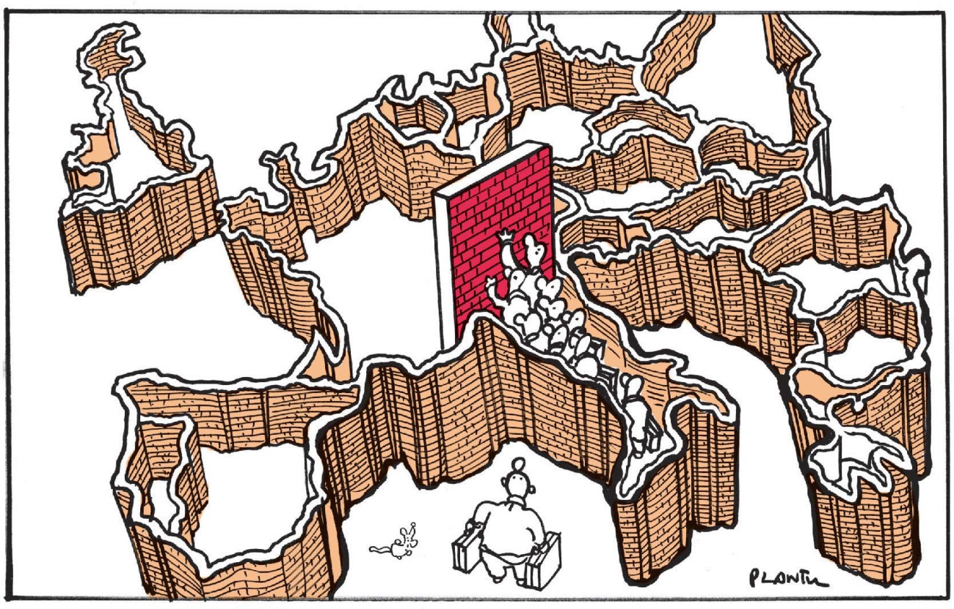
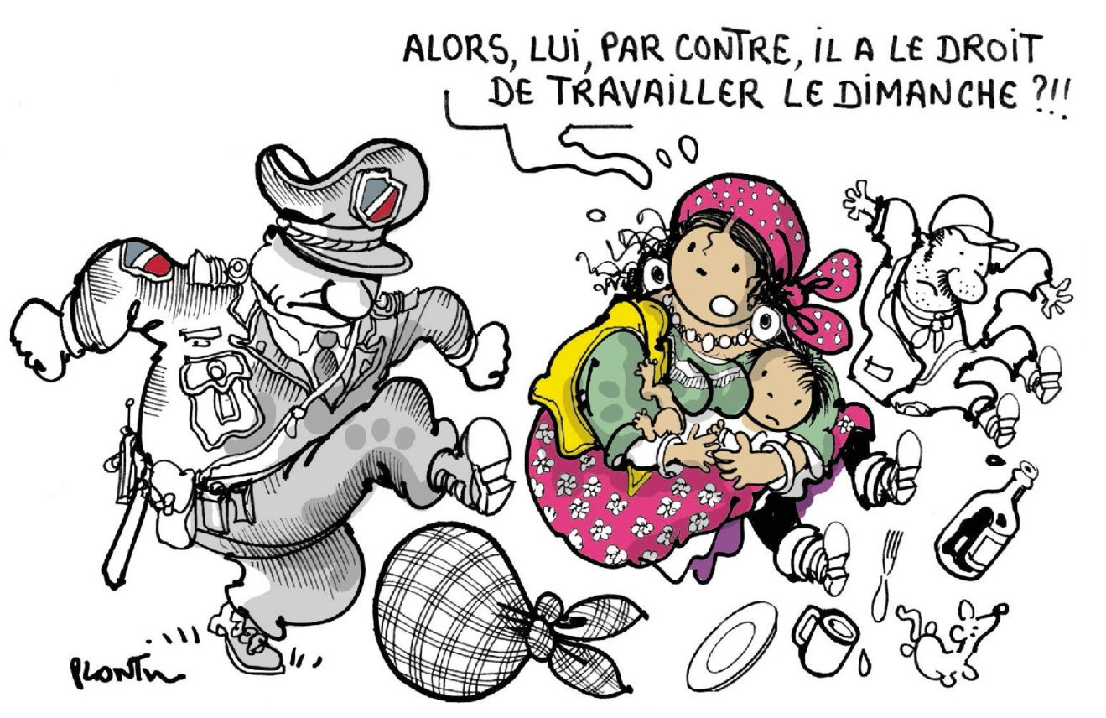
France
© Plantu, Le Monde, 19 April 2011 on temporary Schengen borders
© Plantu, Le Monde, 2nd October 2013

Slide 12
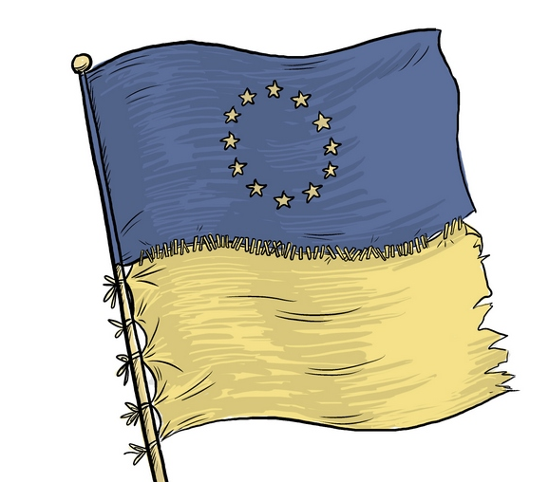
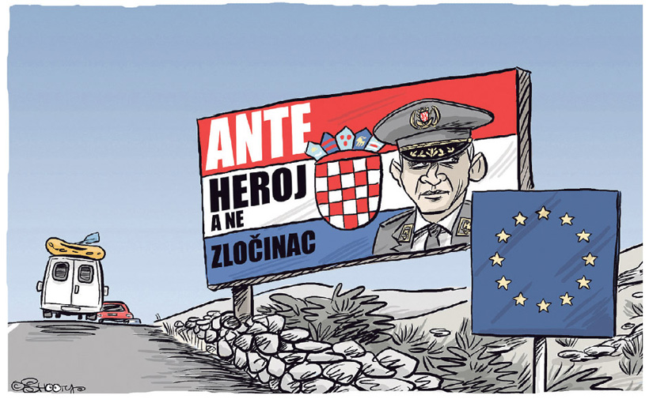
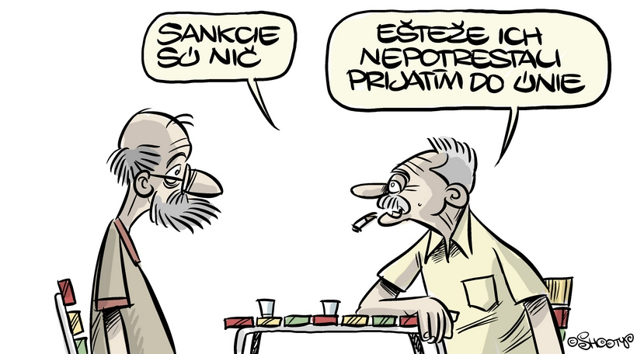
Slovakia
© Shooty, SME 1st July 2013
© Shooty, SME 3rd December 2013
© Shooty, SME 31st July 2014

Slide 13
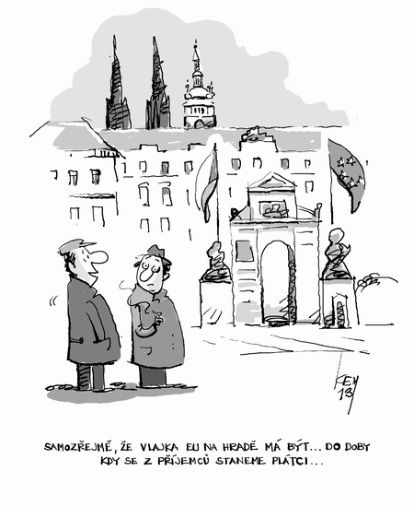
Czech Republic
© Mirek Kemel, MF Dnes, 9th April 2013

Slide 14
Czech Republic
© Mirek Kemel, MF Dnes, 25 February 2013

Slide 15
Future Enlargement:
There is public potential to block enlargement – especially with the consensual style of EU politics
Explain the EU to the public – role of governments as well as the media!
Delegitimise populism, racism and xenophobia
Let’s see how the new Commission (Johannes Hahn) will handle the portfolio of European Neighbourhood Policy & Enlargement Negotiations
Keep working with Western Balkans and the EaP countries – to keep stability and prevent remorse
Luboš Palata: external limits of enlargement – Russia!

Slide 16
Sources
Curticapean, A. (2008): “Bai Ganio and Other Men’s Journeys to Europe: the Boundaries of Balkanism in Bulgarian EU-Accession Discourses”, Perspectives 2008(1): 23-56
European Commission (2014): Eurobarometer 81, July 2014
Risse, T. (2014): “No Demos? Identities and Public Spheres in the Euro Crisis”, Journal of Common Market Studies 52(6): 1207-1215
Füle, Š., Palata, L. (2014): “Debaty think tanku Evropske hodnoty. Pet let v cele politiky rozsireni a sousedstvi”, MZV CR, 17.10.2014 available at: http://www.ceskatelevize.cz/ivysilani/10000000102-debata-think-tanku-evropske-hodnoty/214251000920005-pet-let-v-cele-politiky-rozsireni-a-sousedstvi-eu

